Slide 1

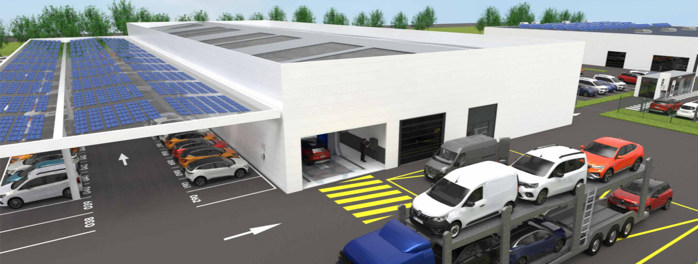
The Renew factory
Dealer’s Format

Slide 2
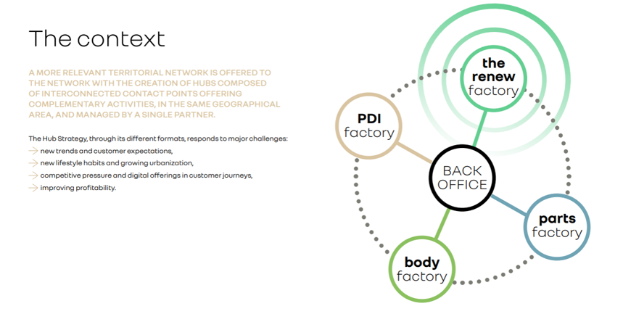
01 – What is the Hub Strategy?

Slide 3

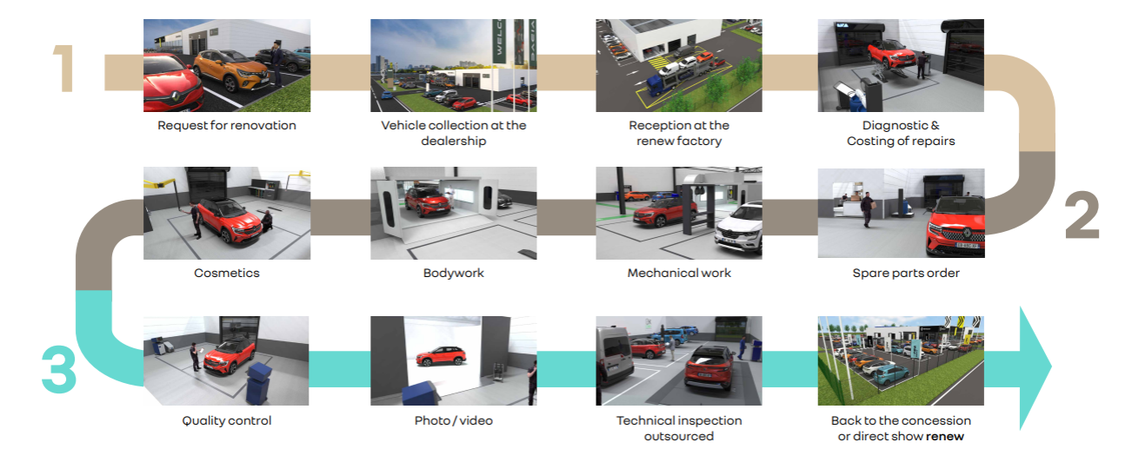
02 – Presentation of the Renew Factory

Slide 4
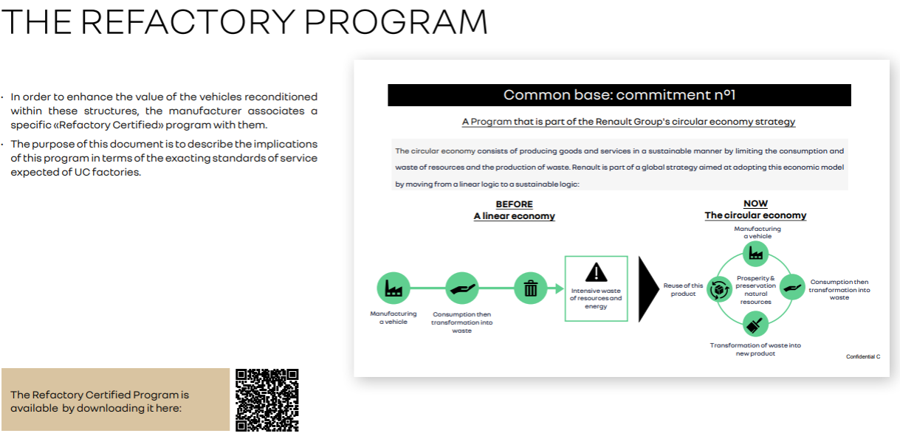

03 - ‘Refactory Certified’ Program

Slide 5
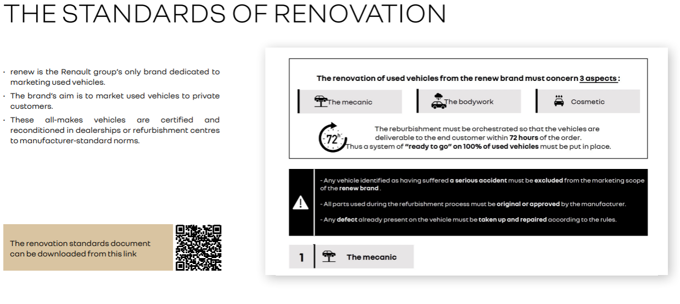

03 - ‘Refactory Certified’ Program

Slide 6
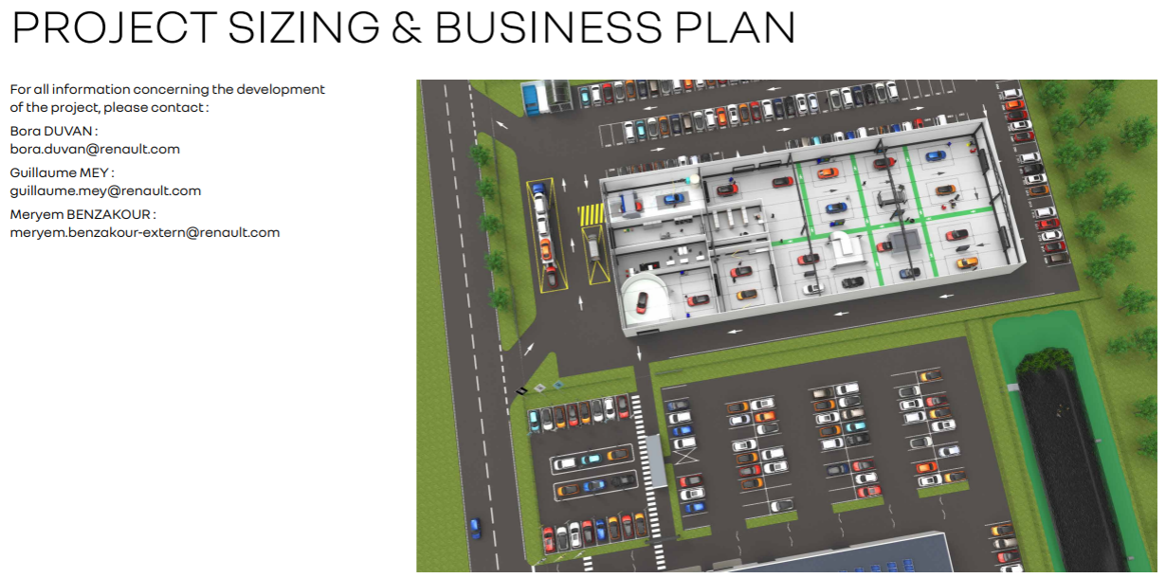
04 – Sizing & Profitability

Slide 7



